Slide 1
Teaching programming
Hussein Al-Rubaye

Slide 2
Plan of study
1- Students will be divided into two groups:
Team1: Study programming concept with Block-based
Team2: Study programming concept with Hybrid based.
Both team will execute same tasks, then they work code-based and answer number of questions about programming fundamental.
2- Both team start program with Python

Slide 3
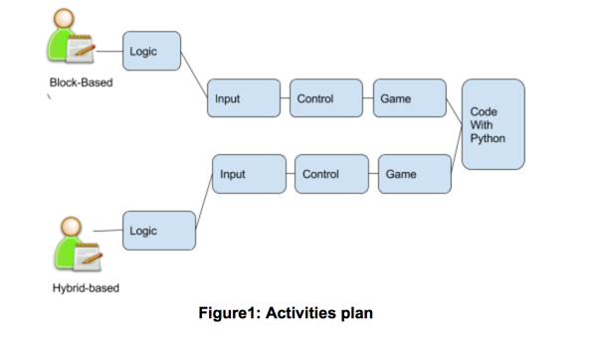

Slide 4
Pre Test
https://goo.gl/LhqJ0q

Slide 5
Work Portal
https://goo.gl/OD23jD

Slide 6
introduction and variables
Hussein Alrubaye

Slide 7
Where should team start?
Team1: Block-based:
https://pencilcode.net
Team2: Hybrid-Based
https://pencilcode.net.dev

Slide 8
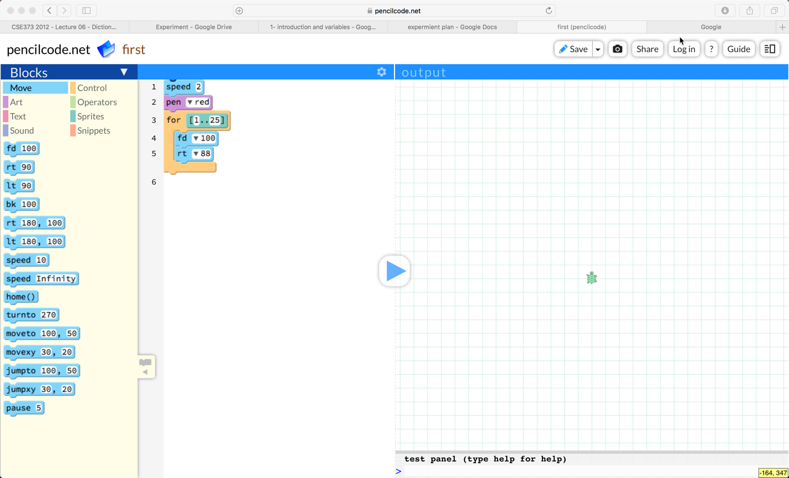

Slide 10
variables

Slide 11
Define variables
Variables are used to store information to be referenced and manipulated in a computer program.
X= 5
y=x
z=x+y

Slide 12
Math Operations
Operations in programming same as operation in math
X= 5
y=10
sum=x+y
mul=x*y
sub=x-y

Slide 13
Task: Develop Simple calculator
X= 5
y=10
sum=x+y
*Modify code to have other operations

Slide 14
Logic Operations
(3>2)=true
(4<5)=false
(4>3)&& (6<8) =true
(4>3)|| (6>8) =true
!(true)=false

Slide 15
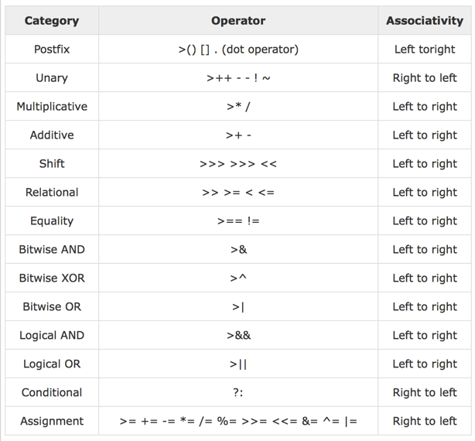
Priorities

Slide 16
Example
3+10*5-10
5*2+3/4

Slide 17
Example
3+10*5-10
5*2+3/4

Slide 18
Input/output

Slide 19
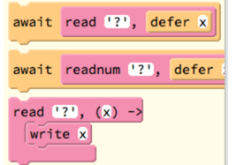
Blocks

Slide 20
Task: Find your age in years
await read '?', defer DOB
Age = 2017 - DOB
write Age

